Slide 1
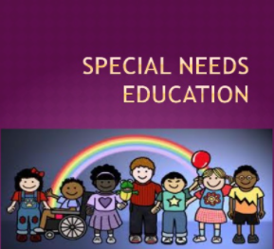
SPECIAL NEEDS AND DISABILITIES
Name
Date
Institution Affiliation

Slide 2
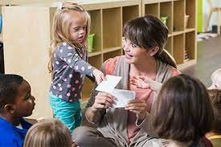
INTRODUCTION
Special education is a learning process (Johnsen et al., 2021).
It enables tutors to understand and guide disabled children.
Disabilities manifest themselves in children differently.
They can be classified as either physical or mental.
Disabled children need to be treated equally to non-disabled ones.
Tender love and care is needed from the tutors all through the learning process.
Notes:
Special education is vital because it allows academicians to gain perfect knowledge on how to deal with disabled children. However, this does not mean that they should not be treated equally to other children who lack disabilities. In both cases, love and care is needed.

Slide 3

IDENTIFICATION OF INDIVIDUALS LIVING WITH DISABIITIES
Disabled individuals can be identified through their health history (Cipriano and Barnes, 2021).
This is realized through assessment.
The special education tutor is required to know all the students.
This is through personal details that are filled as their forms.
Forms should be issued on a regularly to ensure that the information is updated.
Notes:
Disabled children need special facilities to ease their adaptability to the school environment. Disabled children can be identified through their health history of the personal detail forms they fill whenever they are in session.

Slide 4
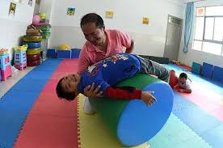
RESPONSE TO INTERVENTION
Response to Intervention (RTI) is an analyzation process for the intensity of disabled needs.
The disabled students would be evaluated for referral.
It is done through three use of three-tier which form RTI.
High qualified gauging of the health, targeted and intensive interventions are done.
All these processes intend to find out which disabled child needs more attention from the tutor than the other.
Notes:
Response to Intervention is carried out in three-tiers which are high qualified gauging of the health, targeted and intensive interventions. All this are done in an attempt to evaluate which disabled child requires a referral.

Slide 5
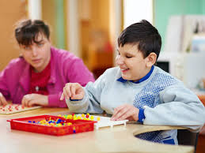
Multi-Tiered System of Supports (MTSS)
MTSS is an approach that is used
by tutors to find out the disabled children who need help.
Disabled people tend to face so many struggles.
The approach identifies the people that need help the most
The technique has focused on using two tiers.
Universal instructions and targeted interventions are the two tiers used (Fleming and Cook, 2021).
They both assist in identifying who needs help the most.
Notes:
MTSS is a technique which is used to find out the most struggling disable children through the use of two tiers only. The tiers are universal instructions and targeted interventions.

Slide 6

REFERRAL OF DISABLED CHILDREN
Guardians realize that their children need social attention at a tender age.
The special needs institution is contacted (Lockwood, et al., 2021).
Evaluation is conducted through MTSS or RTI.
Special need identification is the recognition of the needs that a disabled student has.
Special needs referral is the ability of an institution to accept disabled children.
Notes:
The referral of disabled children would be characterized s their acceptance into special need schools. This is done after the evaluation of the information that is offered by the parents or guardians.

Slide 7
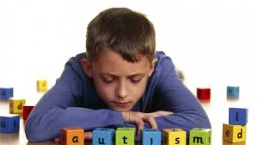
ELIGIBILITY FOR INDIVIDUALS WITH DISABILITIES
Eligibility is the act of finding out whether it is actually true that a person is disabled.
This would be done visually if at all the disabilities are physical.
Eligibility would be established through health aassessme4nt tests to ascertain if a person is mentally disabled.
However, the tests would be done by evaluating whether the children can easily respond to the change within the environment.
Notes:
Eligibility is finding out whether students are really disabled. Health assessment or physical tests can be used to find out whether students are eligible.

Slide 8
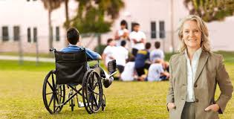
CONCLUSION
Disabled people have to be treated with a lot of care.
Special need tutors should be taught about the process of finding out how eligible the children were.
Disabilities do not render children incapable of carrying out different activities.
MTSS and RTI are the approaches that are used to evaluate the needs that the children have.
These were the most appropriate techniques in evaluating the need for social education.

Slide 9

REFERRENCES
Cipriano, C., & Barnes, T. N. (2021). The observation of special education classrooms by school personnel. Learning Environments Research, 1-19.
Fleming, J. I., & Cook, B. G. (2021). Open access in special education: A review of journal and publisher policies. Remedial and Special Education, 0741932521996461.
Johnsen, B., Čehić, I., Cvitković, D., Dizdarević, A., Hadžić, S., Igrić, L., ... & Zečić, S. (2021). Research project preparation within education and special needs education.
Lockwood, A. B., Farmer, R. L., Bohan, K. J., Winans, S., & Sealander, K. (2021). Academic achievement test use and assessment practices: A national survey of special education administrators. Journal of Psychoeducational Assessment, 39(4), 436-451.

Slide 10



